Slide 1
Procedure-Based Programming
main()
first function invoked
at execution
func1()
func2()
func3()
func4()
...
The functions within a program communicate through values
that they receive and return.

Slide 2
Important Ideas in Software Design
Modularity
• Components can be developed independent of each other.
• Reduce coupling between them.
Abstraction
• View components in terms of their essential features.
• Each component provides an interface that specifies interactions.

Slide 3
Object-Oriented Programming
A programming paradigm based on two principles:
Information hiding – keep the interface separate from the
implementation.
• Users care about the interface and operations of a new data type.
• Only the implementer cares about the implementation details.
Encapsulation – keep the data and the functions that manipulate
them in one place.
Program with a black box!
The two principles are implemented in Java through the “class” facility.
New data types can be created and manipulated as easily
as built-in types.

Slide 4
Application: Banking
Maintain a collection of bank accounts.
If we use procedure-based programming:
storage – some collection
data passing back and forth procedurally
global data pool
tightly coupled code
prune to mistakes
multiple types of banking accounts?

Slide 5
OOP Design
class BankAccount
{
// account state stored in private variables
private float balance;
private String name;
private String TransactionList;
// etc
// public interface
public void deposit(float amount) {
…
}
public double getCurrentBalance() {
…
}
public Report prepareMonthlyReport() {
…
}
// etc
}

Slide 6
Java
data items + methods = programs
public interface + private implementation
private:
Data
Methods
Class Members
public:
Data
Methods

Slide 7
Objects & Classes
A modern software system is a collection of interacting objects that
communicate through well-defined interfaces.
An object has
state – values of instance variables
identity – distinguishable from others
operations – Application Programming Interface (API)
A class is a type.

Slide 8
Principles of OOP
Encapsulation – keeps the data and the functions that manipulate
them in one place,.and hides implementation details. Objects
interact through a well-defined set of operations.
Inheritance – a method for reusing and extending existing code.
Allows derivation of a class of objects from a more general class..
Polymorphism
– same method defined for objects of different types.
– focusing less on object specific types and more on
the object’s available functions.

Slide 9
Why Encapsulation is Your Friend?
implementation independent of functionality
prevention of writing applications that corrupt internal data
preservation of ADT invariants
teamwork – breakup of a complex project into smaller pieces
documentation and maintainability

Slide 10
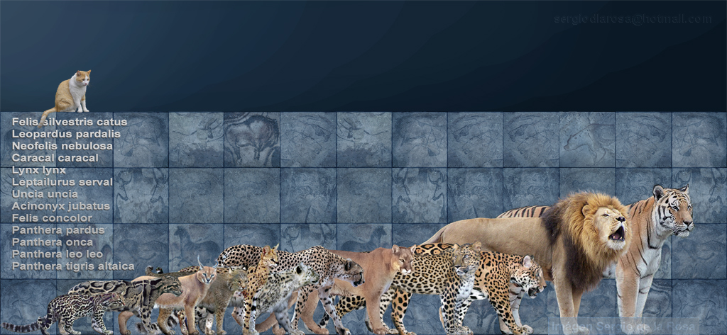
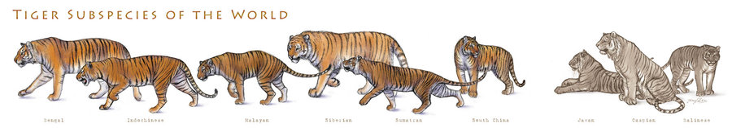
Inheritance in Zoology
Inheritance describes the common attributes and special characteritics
among species of animals.
Mammal
Cat
Primate
Dog
…
Jaguar Lion Tiger
Bengal Indochinese Malayan Siberian Sumantran South China Javan Caspian Balinese

